Slide 1

Programming in Java
Exception Handling
Lovely Professional University, Punjab

Slide 2
Exception

Slide 3
Introduction
An exception is an event, which occurs during the execution of a program, that disrupts the normal flow of the program's instructions.
An exception is an abnormal condition that arises in a code sequence at run time.
A Java exception is an object that describes an exceptional (that is, error) condition that has occurred in a piece of code.
In other words, “An exception is a run-time error.”

Slide 4
Exception Handling
statement 1;
statement 2;
statement 3;
statement 4;
statement 5;//exception occurs
statement 6;
statement 7;
statement 8;
statement 9;
statement 10;
Suppose there is 10 statements in your program and there occurs an exception at statement 5, rest of the code will not be executed i.e. statement 6 to 10 will not run.
If we perform exception handling, rest of the statement will be executed. That is why we use exception handling in java.

Slide 5
Exception Handling
An Exception is a run-time error that can be handled programmatically in the application and does not result in abnormal program termination.
Exception handling is a mechanism that facilitates programmatic handling of run-time errors.
In java, each run-time error is represented by an object.

Slide 6
Exception (Class Hierarchy)
At the root of the class hierarchy, there is a class named ‘Throwable’ which represents the basic features of run-time errors.
There are two non-abstract sub-classes of Throwable.
    Exception : can be handled
    Error : can’t be handled
    RuntimeException is the sub-class of Exception.
    Each exception is a run-time error but all run-time errors are not exceptions.

Slide 7
Throwable
Exception Error
Run-time Exception - VirtualMachine
IOException - ArithmeticException - NoSuchMethod
SQLException - ArrayIndexOutOf - StackOverFlow
BoundsException
- NullPointerException
Checked Exception
Unchecked Exception
Types of Exceptions

Slide 8
Checked Exception
Checked Exceptions are those, that have to be either caught or declared to be thrown in the method in which they are raised.
Unchecked Exception
Unchecked Exceptions are those that are not forced by the compiler either to be caught or to be thrown.
Unchecked Exceptions either represent common programming errors or those run-time errors that can’t be handled through exception handling.

Slide 9
Commonly used sub-classes of Exception
ArithmeticException
ArrayIndexOutOfBoundsException
NumberFormatException
NullPointerException
IOException

Slide 10
Commonly used sub-classes of Errors
VirualMachineError
StackOverFlowError
NoClassDefFoundError
NoSuchMethodError

Slide 11
Scenarios where exceptions may occur
1) Scenario where ArithmeticException occurs
If we divide any number by zero, there occurs an ArithmeticException.
int a=50/0;//ArithmeticException
2) Scenario where NullPointerException occurs
If we have null value in any variable, performing any operation by the variable occurs an NullPointerException.
String s=null;
System.out.println(s.length());//NullPointerException

Slide 12
3) Scenario where NumberFormatException occurs
The wrong formatting of any value, may occur NumberFormatException. Suppose I have a string variable that have characters, converting this variable into digit will occur NumberFormatException.
String s="abc";
int i=Integer.parseInt(s);//NumberFormatException
4) Scenario where ArrayIndexOutOfBoundsException occurs
If you are inserting any value in the wrong index, it would result ArrayIndexOutOfBoundsException as shown below:
int a[]=new int[5];
a[10]=50; //ArrayIndexOutOfBoundsException

Slide 13
Uncaught Exceptions
class Exception_Demo
{
public static void main(String args[])
{
int d = 0;
int a = 42 / d;
}
}
When the Java run-time system detects the attempt to divide by zero, it constructs a new exception object and then throws this exception.
Once an exception has been thrown, it must be caught by an exception handler and dealt with immediately.

Slide 14
In the previous example, we haven’t supplied any exception handlers of our own.
So the exception is caught by the default handler provided by the Java run-time system.
Any exception that is not caught by your program will ultimately be processed by the default handler.
The default handler displays a string describing the exception, prints a stack trace from the point at which the exception occurred, and terminates the program.
java.lang.ArithmeticException: / by zero at Exc0.main(Exc0.java:4)

Slide 15
Why Exception Handling?
When the default exception handler is provided by the Java run-time system , why Exception Handling?
Exception Handling is needed because:
  It allows to fix the error, customize the message .
  It prevents the program from automatically terminating

Slide 16
Exception Handling

Slide 17
Keywords for Exception Handling
try
catch
throw
throws
finally

Slide 18
Keywords for Exception Handling
try
Java try block is used to enclose the code that might throw an exception. It must be used within the method.
try {
Statements whose execution may cause an exception
}
Note: try block is always used either with catch or finally or with both.

Slide 19
Keywords for Exception Handling
catch
catch is used to define a handler.
It contains statements that are to be executed when the exception represented by the catch block is generated.
If program executes normally, then the statements of catch block will not executed.
If no catch block is found in program, exception is caught by JVM and program is terminated.

Slide 20
It must be used after the try block only.
You can use multiple catch block with a single try.

Slide 21
Problem without exception handling
public class Testtrycatch1
{
public static void main(String args[])
{
int data=50/0;//may throw exception
System.out.println("rest of the code...");
}
}
Output:
Exception in thread main java.lang.ArithmeticException:/ by zero

Slide 22
Solution by exception handling
public class Testtrycatch2
{
public static void main(String args[])
{
try
{
int data=50/0;
}
catch(ArithmeticException e){System.out.println(e);}
System.out.println("rest of the code...");
}
}
Output:
Exception in thread main java.lang.ArithmeticException:/ by zero rest of the code...

Slide 23
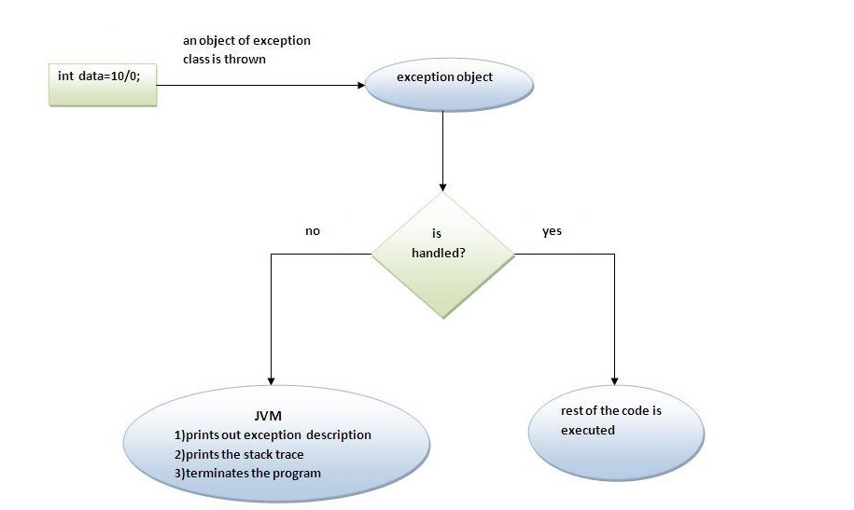
Internal working of java try-catch block

Slide 24
The JVM firstly checks whether the exception is handled or not. If exception is not handled, JVM provides a default exception handler that performs the following tasks:
Prints out exception description.
Prints the stack trace (Hierarchy of methods where the exception occurred).
Causes the program to terminate.
But if exception is handled by the application programmer, normal flow of the application is maintained i.e. rest of the code is executed.

Slide 25
Java Multi catch block
If you have to perform different tasks at the occurrence of different Exceptions, use java multi catch block.
public class TestMultipleCatchBlock
{
public static void main(String args[])
{
try
{
int a[]=new int[5];
a[5]=30/0;
}
catch(ArithmeticException e){System.out.println("task1 is completed");}
catch(ArrayIndexOutOfBoundsException e){System.out.println("task 2 completed");}
catch(Exception e){System.out.println("common task completed");}
System.out.println("rest of the code...");
}
}
Output:task1 completed
rest of the code...
Notes:
ExceptExample.java

Slide 26
Rule1: At a time only one Exception is occured and at a time only one catch block is executed.
Rule2: All catch blocks must be ordered from most specific to most general i.e. catch for ArithmeticException must come before catch for Exception .

Slide 27
class TestMultipleCatchBlock1
{
public static void main(String args[])
{
Try
{
int a[]=new int[5];
a[5]=30/0;
}
catch(Exception e){System.out.println("common task completed");}
catch(ArithmeticException e){System.out.println("task1 is completed");}
catch(ArrayIndexOutOfBoundsException e){System.out.println("task 2 completed");}
System.out.println("rest of the code...");
}
}
Output:
Compile-time error

Slide 28
Nested try block
Sometimes a situation may arise where a part of a block may cause one error and the entire block itself may cause another error. In such cases, exception handlers have to be nested.
Syntax:
....
try
{
statement 1;
statement 2;
try
{
statement 1;
statement 2;
}
catch(Exception e)
{
}
}
catch(Exception e)
{
}
....

Slide 29
class Excep6{
public static void main(String args[]){
try{
try{
System.out.println("going to divide");
int b =39/0;
}catch(ArithmeticException e){System.out.println(e);}
try{
int a[]=new int[5];
a[5]=4;
}catch(ArrayIndexOutOfBoundsException e){System.out.println(e);}
System.out.println("other statement”);
}catch(Exception e){System.out.println("handeled");}
System.out.println("normal flow..");
}
}
Send Your Large Files EasilyThat’s right! Your large

Slide 30
Java finally block
Java finally block is always executed whether exception is handled or not.
Java finally block is a block that is used to execute important code such as closing connection, stream etc.
Java finally block follows try or catch block.

Slide 31
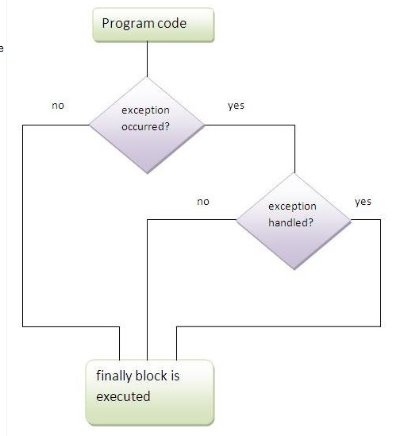
Execution of Finally Block

Slide 32
Note: If you don't handle exception, before terminating the program, JVM executes finally block(if any).

Slide 33
Example: Exception Doesn’t Occur
class TestFinallyBlock{
public static void main(String args[]){
try{
int data=25/5;
System.out.println(data);
}
catch(NullPointerException e){System.out.println(e);}
finally{System.out.println("finally block is always executed");}
System.out.println("rest of the code...");
}
}
Output:5
finally block is always executed
rest of the code...

Slide 34
Example: Exception Occurs & Not Handled
class TestFinallyBlock1{
public static void main(String args[]){
try{
int data=25/0;
System.out.println(data);
}
catch(NullPointerException e){System.out.println(e);}
finally{System.out.println("finally block is always executed");}
System.out.println("rest of the code...");
}
}
Output:finally block is always executed
Exception in thread main java.lang.ArithmeticException:/ by zero

Slide 35
Example: Exception Occurs & Handled
public class TestFinallyBlock2{
public static void main(String args[]){
try{
int data=25/0;
System.out.println(data);
}
catch(ArithmeticException e){System.out.println(“Code Executed”);}
finally{System.out.println("finally block is always executed");}
System.out.println("rest of the code...");
}
}
Output: Code Executed
finally block is always executed
rest of the code...

Slide 36
Rule: For each try block there can be zero or more catch blocks, but only one finally block.
Note: The finally block will not be executed if program exits(either by calling System.exit() or by causing a fatal error that causes the process to abort).

Slide 37
Java throw Exception
The Java throw keyword is used to explicitly throw an exception.
We can throw either checked or unchecked exception in java by throw keyword. The throw keyword is mainly used to throw custom exception.
If you are creating your own Exception that is known as custom exception or user-defined exception. Java custom exceptions are used to customize the exception according to user need.
By the help of custom exception, you can have your own exception and message.
The syntax of java throw keyword is given below.
throw exception;

Slide 38
throw
used for explicit exception throwing.
throw(Exception obj);
‘throw’ keyword can be used:
to throw user defined exception
to customize the message to be displayed by predefined exceptions
to re-throw a caught exception
  Note: System-generated exceptions are automatically thrown by the Java run-time system.

Slide 39
Example
public class TestThrow1
{
static void validate(int age)
{
if(age<18)
throw new ArithmeticException("not valid");
else
System.out.println("welcome to vote");
}
public static void main(String args[])
{
validate(13);
System.out.println("rest of the code...");
}
}
Output:
Exception in thread main java.lang.ArithmeticException: not valid
Notes:
TestThrow2.java

Slide 40
Java throws keyword
The Java throws keyword is used to declare an exception.
It gives an information to the programmer that there may occur an exception so it is better for the programmer to provide the exception handling code so that normal flow can be maintained.
Exception Handling is mainly used to handle the checked exceptions.
If there occurs any unchecked exception such as NullPointerException, it is programmers fault that he is not performing check up before the code being used.
Syntax of java throws
return_type method_name() throws exception_class_name
{
//method code
}

Slide 41
Which exception should be declared
Ans) checked exception only, because:
unchecked Exception: under your control so correct your code.
error: beyond your control e.g. you are unable to do anything if there occurs VirtualMachineError or StackOverflowError.
Advantage of Java throws keyword
Now Checked Exception can be propagated (forwarded in call stack).
It provides information to the caller of the method about the exception.

Slide 42
Example
import java.io.IOException;
class Testthrows1{
void m()throws IOException{
throw new IOException("device error");//checked exception
}
void n()throws IOException{
m();
}
void p(){
try{
n();
}catch(Exception e){System.out.println("exception handled");}
}
public static void main(String args[]){
Testthrows1 obj=new Testthrows1();
obj.p();
System.out.println("normal flow...");
} }
Output:
exception handled
normal flow...

Slide 43
Rule: If you are calling a method that declares an exception, you must either caught or declare the exception.
There are two cases:
Case1:You caught the exception i.e. handle the exception using try/catch.
Case2:You declare the exception i.e. specifying throws with the method.

Slide 44
Case1:Handle the exception
import java.io.*;
class M
{
void method()throws IOException
{
throw new IOException("device error");
}
}
public class Testthrows2
{
public static void main(String args[])
{
try
{
M m=new M();
m.method();
}
catch(Exception e){System.out.println("exception handled");}
System.out.println("normal flow...");
}
}
Output: exception handled
normal flow...

Slide 45
Case2: Declare the exception
A)In case you declare the exception, if exception does not occur, the code will be executed fine.
B)In case you declare the exception if exception occures, an exception will be thrown at runtime because throws does not handle the exception.

Slide 46
A)Program if exception does not occur
import java.io.*;
class M
{
void method()throws IOException
{
System.out.println("device operation performed");
}
}
class Testthrows3
{
public static void main(String args[])throws IOException
{//declare exception
M m=new M();
m.method();
System.out.println("normal flow...");
}
}
Output: device operation performed
normal flow...

Slide 47
B)Program if exception occurs
import java.io.*;
class M
{
void method()throws IOException
{
throw new IOException("device error");
}
}
class Testthrows4
{
public static void main(String args[]) throws IOException
{//declare exception
M m=new M();
m.method();
System.out.println("normal flow...");
}
}
Output:Runtime Exception

Slide 48
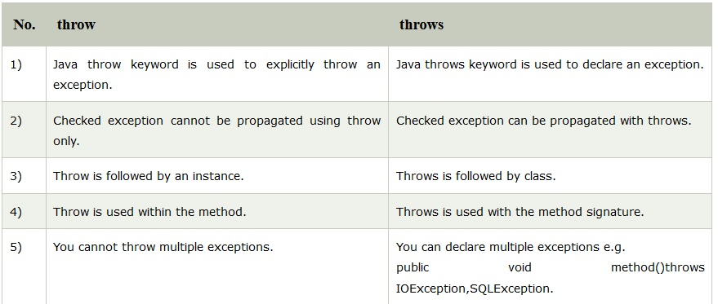
Difference between throw and throws

Slide 49
Java throw example
void m()
{
throw new ArithmeticException("sorry");
}
Java throws example
void m()throws ArithmeticException
{
//method code
}
Java throw and throws example
void m()throws ArithmeticException
{
throw new ArithmeticException("sorry");
}

Slide 50
Java Exception Propagation
An exception is first thrown from the top of the stack and if it is not caught, it drops down the call stack to the previous method,If not caught there, the exception again drops down to the previous method, and so on until they are caught or until they reach the very bottom of the call stack. This is called exception propagation.
Rule: By default Unchecked Exceptions are forwarded in calling chain (propagated).

Slide 51
class TestExceptionPropagation1
{
void m()
{
int data=50/0;
}
void n()
{
m();
}
void p()
{
try
{
n();
}catch(Exception e){System.out.println("exception handled");}
}
public static void main(String args[])
{
TestExceptionPropagation1 obj=new TestExceptionPropagation1();
obj.p();
System.out.println("normal flow...");
}
}
Output:exception handled
normal flow...

Slide 52
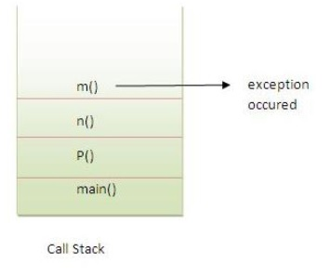
In the above example exception occurs in m() method where it is not handled,
So it is propagated to previous n() method where it is not handled, again it is propagated to p() method where exception is handled.
Exception can be handled in any method in call stack either in main() method,p() method,n() method or m() method.

Slide 53
Rule: By default, Checked Exceptions are not forwarded in calling chain (propagated).
class TestExceptionPropagation2{
void m(){
throw new java.io.IOException("device error");//checked exception
}
void n(){
m();
}
void p(){
try{
n();
}catch(Exception e){System.out.println("exception handeled");}
}
public static void main(String args[]){
TestExceptionPropagation2 obj=new TestExceptionPropagation2();
obj.p();
System.out.println("normal flow");
}
}
Output:Compile Time Error

Slide 54
Defining Generalized Exception Handler
A generalized exception handler is one that can handle the exceptions of all types.
If a class has a generalized as well as specific exception handler, then the generalized exception handler must be the last one.

Slide 55
class Divide{
public static void main(String arr[]){
try {
int a= Integer.parseInt(arr[0]);
int b= Integer.parseInt(arr[1]);
int c = a/b;
System.out.println(“Result is: ”+c);
}
catch (Throwable e)
{
System.out.println(e);
}
}
}

Slide 56
Defining Custom Exceptions
We can create our own Exception sub-classes by inheriting Exception class.
The Exception class does not define any methods of its own.
It inherits those methods provided by Throwable.
Thus, all exceptions, including those that we create, have the methods defined by Throwable available to them.

Slide 57
Constructor for creating Exception
Exception( )
Exception(String msg)
A custom exception class is represented by a subclass of Exception / Throwable.
It contains the above mentioned constructor to initialize custom exception object.

Slide 58
class Myexception extends Throwable
{
public Myexception(int i)
{
System.out.println("you have entered ." +i +" : It exceeding the limit");
}
}

Slide 59
public class ExceptionTest {
public void show(int i) throws Myexception {
if(i>100)
throw new Myexception(i);
else
System.out.println(+i+" is less then 100 it is ok");
}
public static void main(String []args){
int i=Integer.parseInt(args[0]);
int j=Integer.parseInt(args[1]);
ExceptionTest t=new ExceptionTest();
try{
t.show(i); t.show(j);
}
catch(Throwable e) {
System.out.println("catched exception is "+e);
}
}
}

Slide 60
Try with Resource Statement
JDK 7 introduced a new version of try statement known as try-with-resources statement.
This feature add another way to exception handling with resources management
It is also referred to as automatic resource management.
Syntax:
try(resource-specification)
{ //use the resource }
catch(Exception ex) {...}

Slide 61
Try with Resource Statement
The try statement contains a parenthesis in which one or more resources is declared.
Any object that implements java.lang.AutoCloseable or java.io.Closeable, can be passed as a parameter to try statement.
A resource is an object that is used in program and must be closed after the program is finished.
The try-with-resources statement ensures that each resource is closed at the end of the statement, you do not have to explicitly close the resources.

Slide 62
Example
import java.io.*;
class Test {
public static void main(String[] rk) {
try(BufferedReader br=new BufferedReader(
new FileReader("d:\\myfile.txt")))
{ String str;
while((str=br.readLine())!=null) { System.out.println(str); } }catch(IOException ie)
{ System.out.println("exception"); } } }

Slide 63


